Slide 1

CS101 Data Structure
Heaps and Priority Queues
Textbook Ch 6
Notes:
Adapted from the slides by Douglas Wilhelm Harder of U Waterloo (https://ece.uwaterloo.ca/~dwharder/aads/Lecture_materials/)
May also contain material from the slides at https://courses.cs.washington.edu/courses/cse326/03wi/326lecturesb.shtml (by Dan Suciu of U Washington)

Slide 2
Outline
Priority queue
Binary heap
Heapsort

Slide 3
Outline
This topic will:
Review queues
Discuss the concept of priority and priority queues
Look at two simple implementations:
Arrays of queues
AVL trees
Introduce heaps, an alternative tree structure which has better run-time characteristics

Slide 4
Background
We have discussed Abstract Lists with explicit linear orders
Arrays, linked lists, strings
We saw three cases which restricted the operations:
Stacks, queues, deques
Following this, we looked at search trees for storing implicit linear orders: Abstract Sorted Lists
Run times were generally Θ(ln(n))
We will now look at a restriction on an implicit linear ordering:
Priority queues

Slide 5
Definition
Queues
The order may be summarized by first in, first out
Priority queues
Each object is associated with a priority
The value 0 has the highest priority, and
The higher the number, the lower the priority
We pop the object which has the highest priority

Slide 6
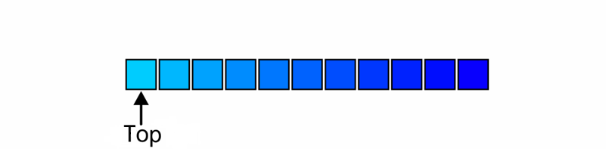
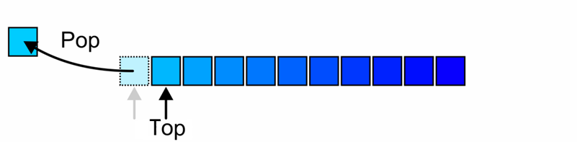
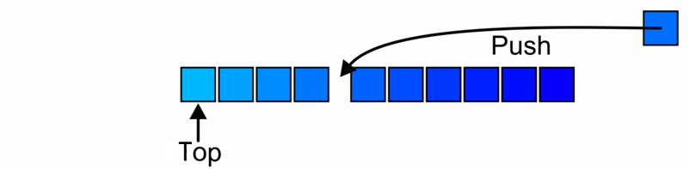
Operations
The top of a priority queue is the object with highest priority
Popping from a priority queue removes the current highest priority object:
Push places a new object into the appropriate place

Slide 7
Lexicographical Priority
Priority may also depend on multiple variables:
Two values specify a priority: (a, b)
A pair (a, b) has higher priority than (c, d) if:
a < c, or
a = c and b < d
For example,
(5, 19), (13, 1), (13, 24), and (15, 0) all have higher priority than (15, 7)

Slide 8
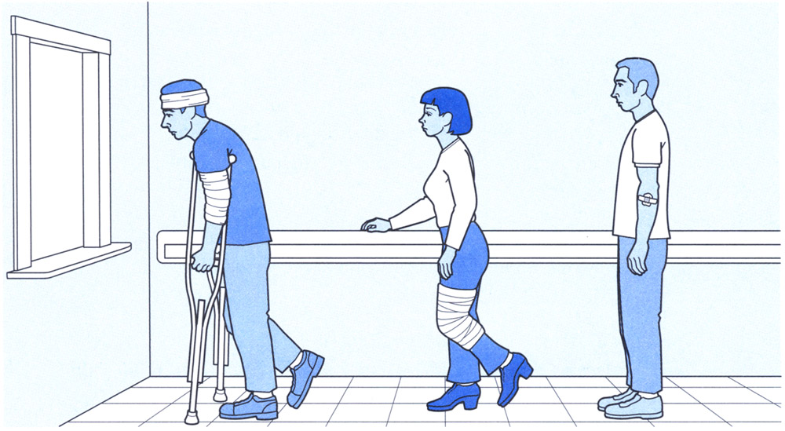
Application
Notes:
Image from http://younginc.site11.com/source/5895/fos0092.html

Slide 9
Application
Process priority in operation systems
In Unix, you may set the priority of a process, e.g.,
% nice +15 ./a.out
reduces the priority of the execution of the routine a.out by 15
Notes:
Linux Schedular: CFS, “nice” defines the priority
This allows the processor to be used by interactive programs
This does not significantly affect the run-time of CPU-bound processes

Slide 10
Application
We will see later how priority queue is used in Huffman coding.
2
4
4
4
sp
4
e
8
2
2
k
1
.
1
r
2
s
2
n
2
a
2
E
1
i
1
y
1
l
1

Slide 11
Implementations
Our goal is to make the run time of each operation as close to Θ(1) as possible
We will look at an implementation using a data structure we already know:
Multiple queues — one for each priority
Then we will introduce a more appropriate data structure: heap

Slide 12
Multiple Queues
Assume there is a fixed number of priorities, say M
Create an array of M queues
Push a new object onto the queue corresponding to the priority
Top and pop find the first non-empty queue with highest priority
Notes:
12

Slide 13
Multiple Queues
template <typename Type, int M>
class Multiqueue {
private:
queue<Type> queue_array[M];
int queue_size;
public:
Multiqueue();
bool empty() const;
Type top() const;
void push( Type const &, int );
Type pop();
};
template <typename Type, int M>
Multiqueue<Type>::Multiqueue():
queue_size( 0 ) {
// The compiler allocates memory for the M queues
// and calls the constructor on each of them
}
template <typename Type, int M>
bool Multiqueue<Type>::empty() const{
return ( queue_size == 0 );
}

Slide 14
Multiple Queues
template <typename Type, int M>
void Multiqueue<Type>::push( Type const &obj, int pri ) {
if ( pri < 0 || pri >= M ) {
throw illegal_argument();
}
queue_array[pri].push( obj );
++queue_size;
}
template <typename Type, int M>
Type Multiqueue<Type>::top() const {
for ( int pri = 0; pri < M; ++pri ) {
if ( !queue_array[pri].empty() ) {
return queue_array[pri].front();
}
}
// The priority queue is empty
throw underflow();
}
template <typename Type, int M>
Type Multiqueue<Type>::pop() {
for ( int pri = 0; pri < M; ++pri ) {
if ( !queue_array[pri].empty() ) {
--queue_size;
return queue_array[pri].pop();
}
}
// The priority queue is empty
throw underflow();
}

Slide 15
Multiple Queues
The run times are reasonable:
Push is Θ(1)
Top and pop are both O(M)
Problems:
It restricts the range of priorities
The memory requirement is Θ(M + n)

Slide 16
AVL Trees
We could simply insert the objects into an AVL tree where the order is given by the stated priority:
Insertion is Θ(ln(n)) void insert( Type const & );
Top is Θ(ln(n)) Type front();
Remove is Θ(ln(n)) bool remove( front() );
There is significant overhead for maintaining both the tree and the corresponding balance

Slide 17
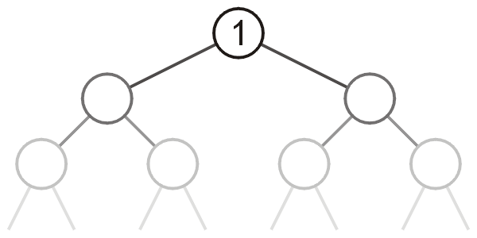
Heaps
Can we do better?
We need a heap
A tree with the top object at the root
We will look at binary heaps
Numerous other heaps exists:
d-ary heaps
Leftist heaps
Skew heaps
Binomial heaps
Fibonacci heaps
Bi-parental heaps

Slide 18
Summary
This topic:
Introduced priority queues
Considered two obvious implementations:
Arrays of queues
AVL trees
Discussed the run times and claimed that a variation of a tree, a heap, can do better
Notes:
18

Slide 19
References
Cormen, Leiserson, Rivest and Stein, Introduction to Algorithms, The MIT Press, 2001, §6.5, pp.138-44.
Mark A. Weiss, Data Structures and Algorithm Analysis in C++, 3rd Ed., Addison Wesley, 2006, Ch.6, p.213.
Joh Kleinberg and Eva Tardos,
Algorithm Design, Pearson, 2006, §2.5, pp.57-65.
Elliot B. Koffman and Paul A.T. Wolfgang,
Objects, Abstractions, Data Structures and Design using C++, Wiley, 2006, §8.5, pp.489-96
These slides are provided for the ECE 250 Algorithms and Data Structures course. The material in it reflects Douglas W. Harder’s best judgment in light of the information available to him at the time of preparation. Any reliance on these course slides by any party for any other purpose are the responsibility of such parties. Douglas W. Harder accepts no responsibility for damages, if any, suffered by any party as a result of decisions made or actions based on these course slides for any other purpose than that for which it was intended.

Slide 20
Outline
Priority queue
Binary heap
Heapsort

Slide 21
Outline
In this topic, we will:
Define a binary min-heap
Look at some examples
Operations on heaps:
Top
Pop
Push
An array representation of heaps
Define a binary max-heap
Using binary heaps as priority queues

Slide 22
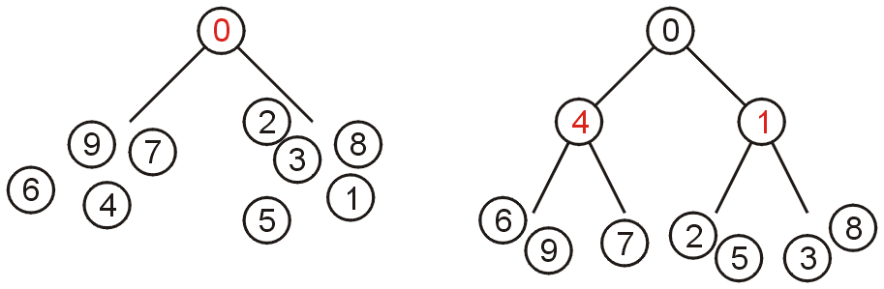
Definition
A non-empty tree is a min-heap if
The key associated with the root is less than or equal to the keys associated with the sub-trees (if any)
The sub-trees (if any) are also min-heaps
There is no other relationship between the elements in the subtrees!
Notes:
From this definition:
A single node is a min-heap
All keys in either sub-tree are greater than the root key

Slide 23
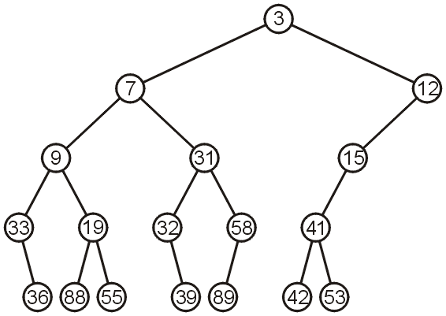
Example
This is a (naive) binary min-heap:

Slide 24
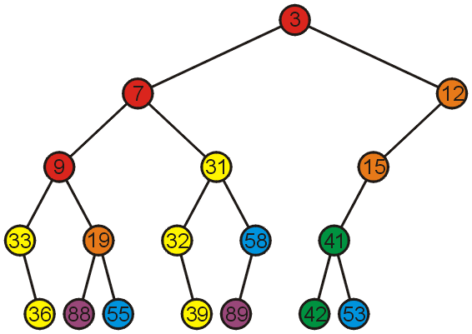
Example
Adding colour, we observe
The left subtree has the smallest (7) and the largest (89) objects
No relationship between items with similar priority

Slide 25
Operations
We will consider three operations:
Top
Pop
Push
Notes:
25

Slide 26
Example
We can find the top object in Θ(1) time: 3

Slide 27
Pop
To remove the minimum object:
Promote the node of the sub-tree which has the least value
Recursively process the sub-tree from which we promoted the least value

Slide 28
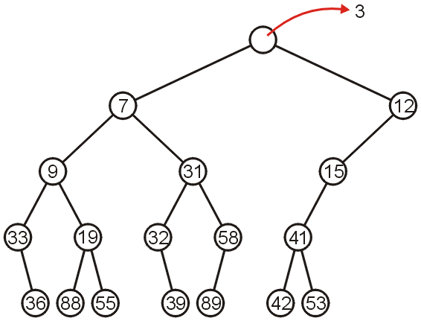
Pop
Using our example, we remove 3:

Slide 29
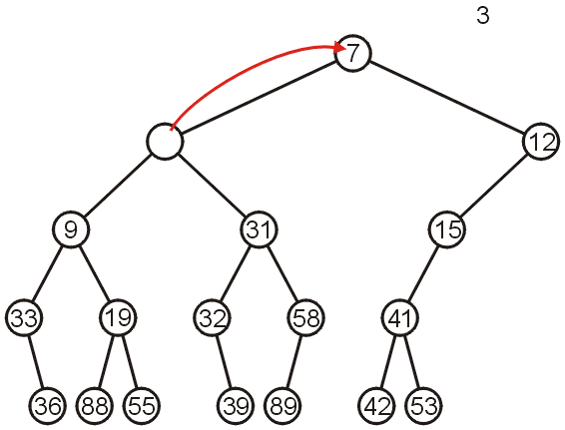
Pop
We promote 7 (the minimum of 7 and 12) to the root:

Slide 30
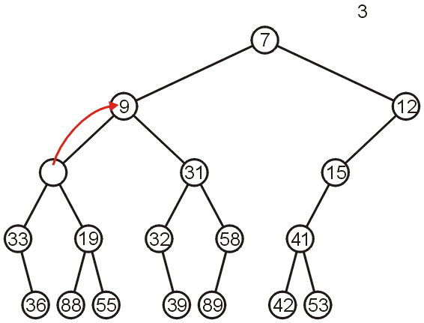
Pop
In the left sub-tree, we promote 9:
7<9, because 9 was the child of 7
7<12, because we promoted the smaller child

Slide 31
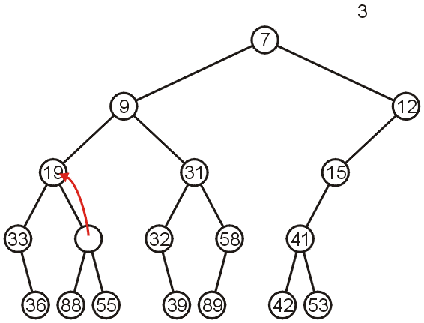
Pop
Recursively, we promote 19:

Slide 32
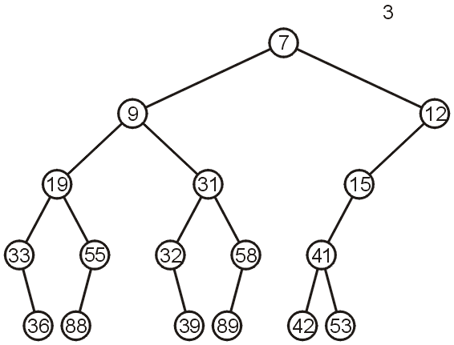
Pop
Finally, 55 is a leaf node, so we promote it and delete the leaf

Slide 33
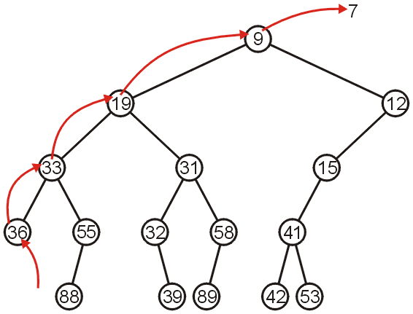
Pop
Repeating this operation again, we can remove 7:

Slide 34
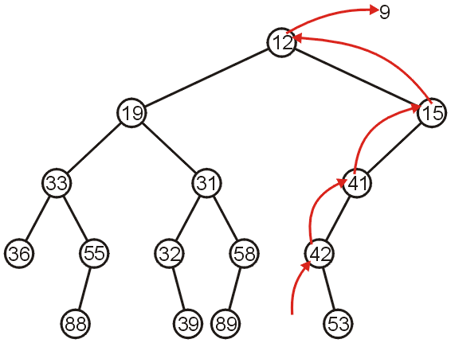
Pop
If we remove 9, we must now promote from the right sub-tree:

Slide 35
Push
Inserting into a heap may be done either:
At a leaf (move it up if it is smaller than the parent)
At the root (insert the larger object into one of the subtrees)
We will use the first approach with binary heaps
Other heaps use the second

Slide 36
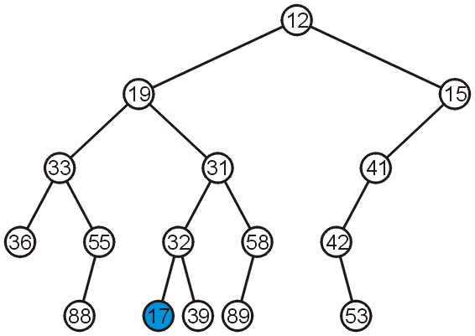
Push
Inserting 17 into the last heap
Select an arbitrary node to insert a new leaf node:

Slide 37
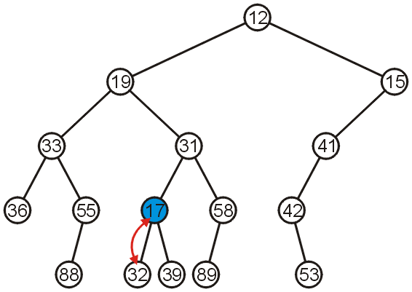
Push
The node 17 is less than the node 32, so we swap them

Slide 38
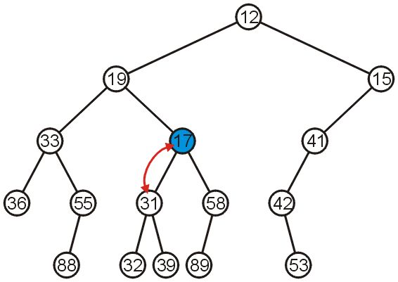
Push
The node 17 is less than the node 31; swap them
31 is smaller than 32 and 39 because 31 was the ancestor of 32 and 39

Slide 39
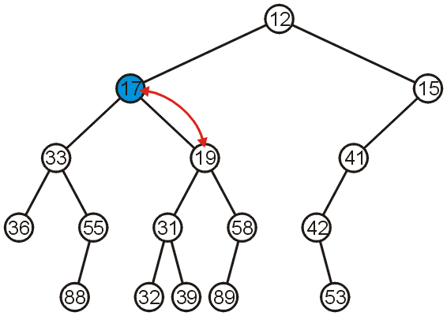
Push
The node 17 is less than the node 19; swap them

Slide 40
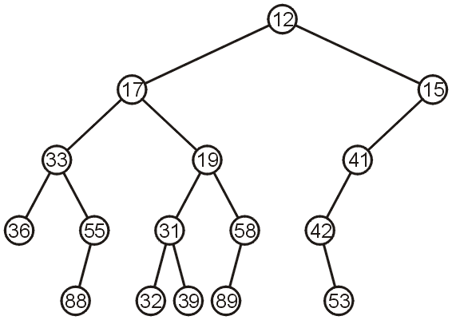
Push
The node 17 is greater than 12 so we are finished

Slide 41
Push
This process is called percolation, that is, the lighter (smaller) objects move up from the bottom of the min-heap

Slide 42
Implementations
With binary search trees, we introduced the concept of balance
From this, we looked at:
AVL Trees
B-Trees
Red-black Trees (not course material)
How can we determine where to insert so as to keep balance?

Slide 43
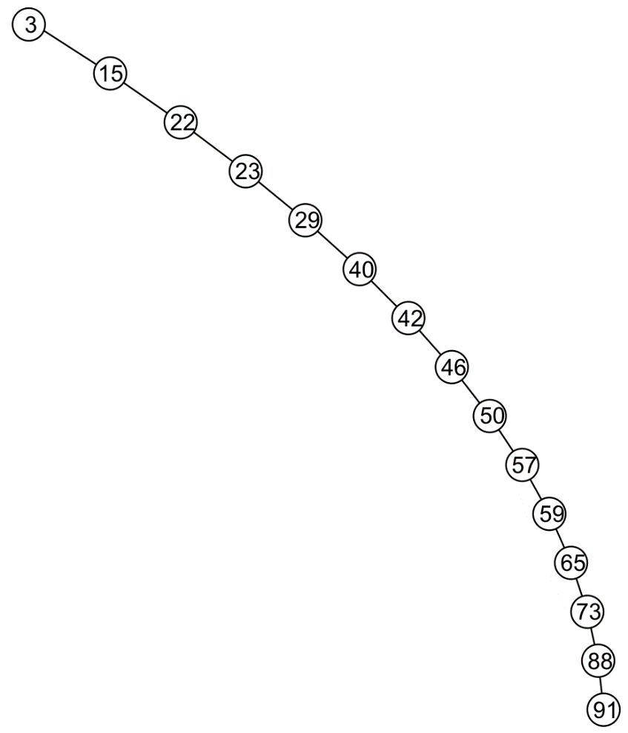
Time Complexity
Time complexity of pop and push?
O(n)
Worst case: the binary tree is highly unbalanced
Can we do better?
Keep balance of the binary tree

Slide 44
Balance
There are multiple means of keeping balance with binary heaps:
Complete binary trees
Leftist heaps
Skew heaps
We will look at using complete binary trees
It has optimal memory characteristics but sub-optimal run-time characteristics
This defines the actual “binary heap”

Slide 45
Complete Trees
By using complete binary trees, we will be able to maintain, with minimal effort, the complete tree structure
We have already seen
It is easy to store a complete tree as an array
If we can store a heap of size n as an array of size Θ(n), this would be great!

Slide 46
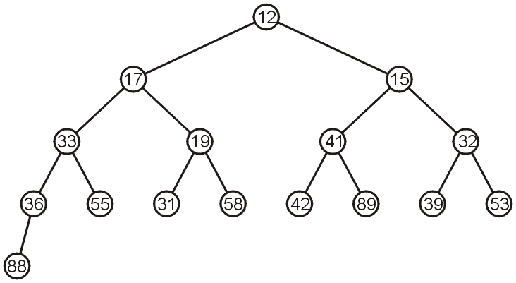
Complete Trees
For example, the previous heap may be represented as the following (non-unique!) complete tree:

Slide 47
Complete Trees: Push
If we insert into a complete tree, we need only place the new node as a leaf node in the appropriate location and percolate up

Slide 48
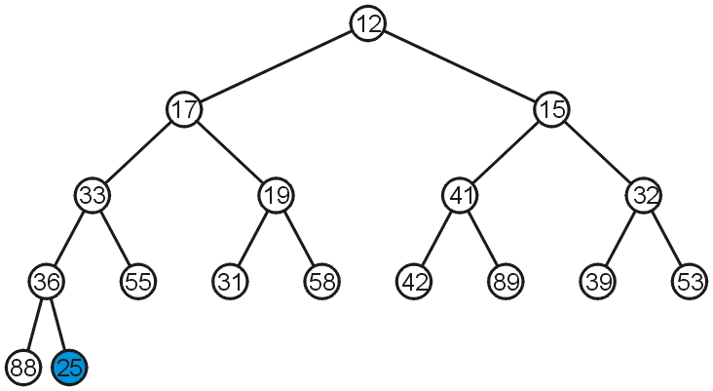
Complete Trees: Push
For example, push 25:

Slide 49
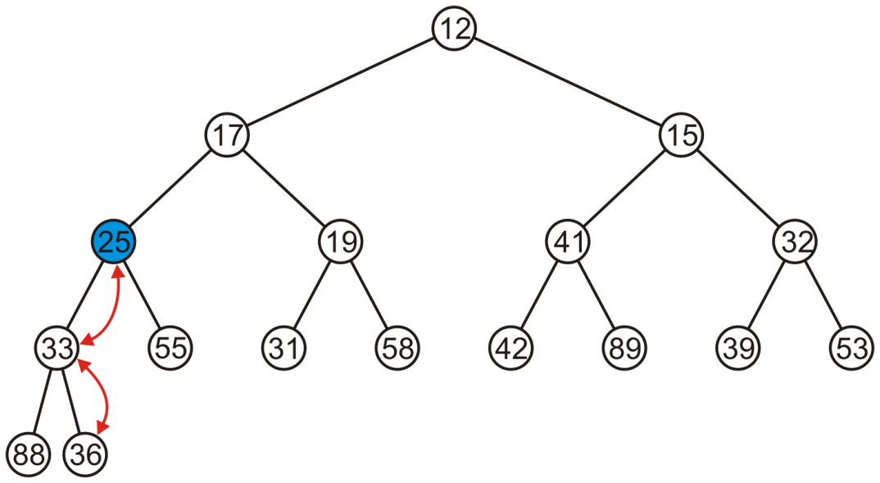
Complete Trees: Push
We have to percolate 25 up into its appropriate location
The resulting heap is still a complete tree

Slide 50
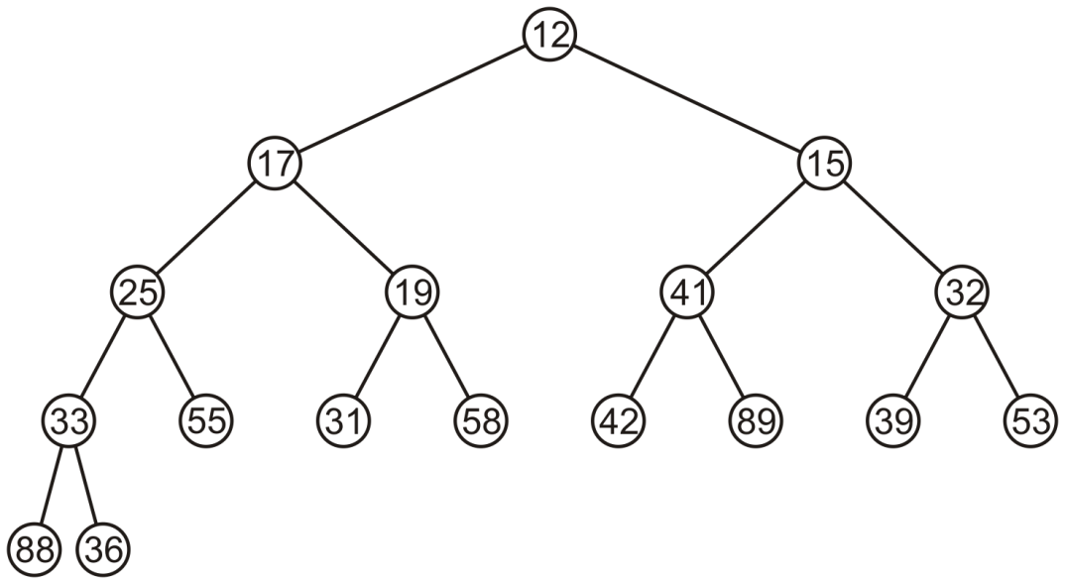
Complete Trees: Pop
Suppose we want to pop the top entry: 12

Slide 51
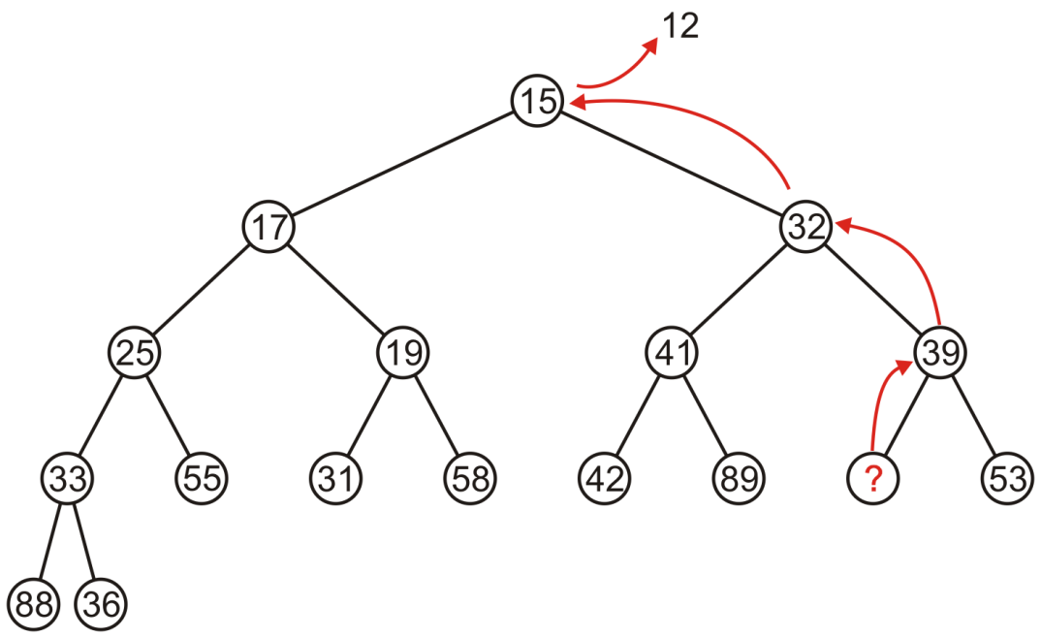
Complete Trees: Pop
Percolating up creates a hole leading to a non-complete tree
What’s wrong?

Slide 52
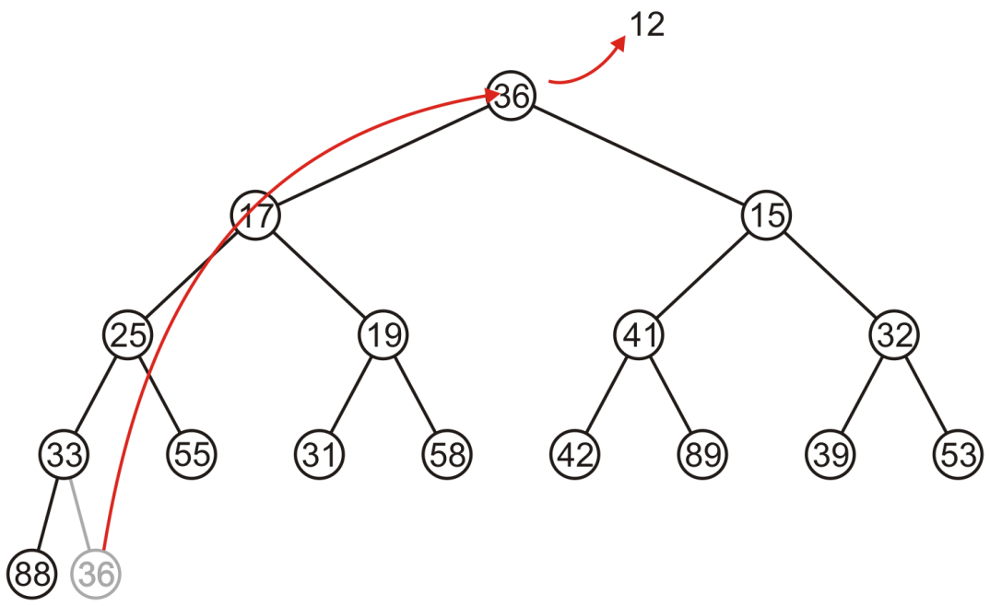
Complete Trees: Pop
Instead, copy the last entry in the heap to the root

Slide 53
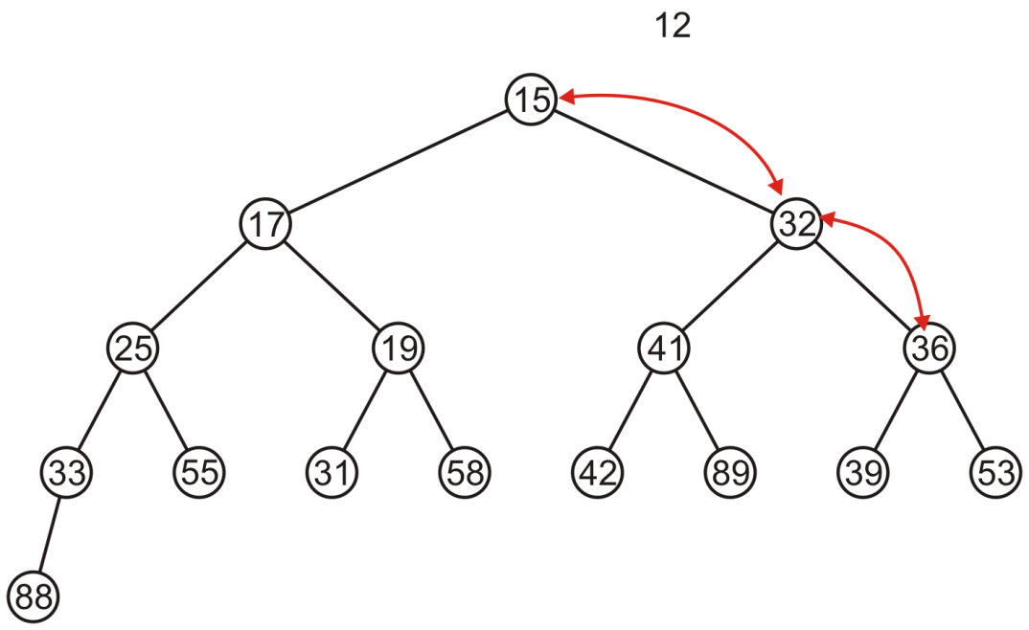
Complete Trees: Pop
Now, percolate 36 down swapping it with the smallest of its children
We halt when both children are larger

Slide 54
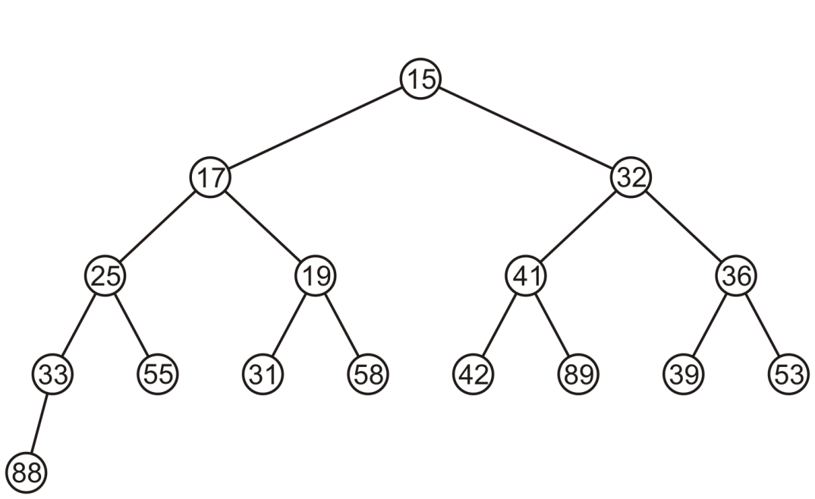
Complete Trees: Pop
The resulting tree is now still a complete tree:

Slide 55
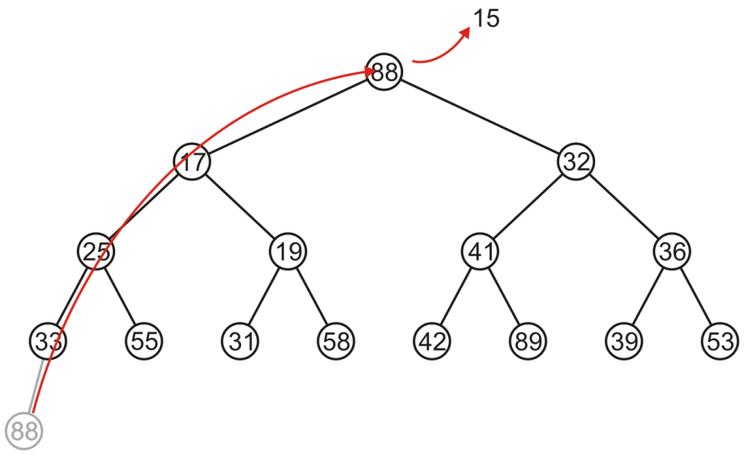
Complete Trees: Pop
Again, popping 15, copy up the last entry: 88

Slide 56
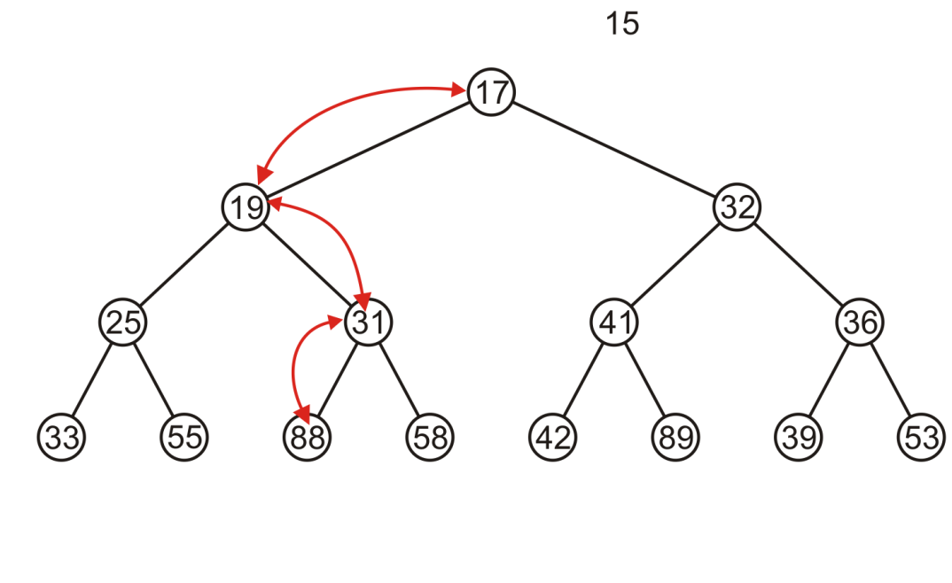
Complete Trees: Pop
This time, it gets percolated down to the point where it has no children

Slide 57
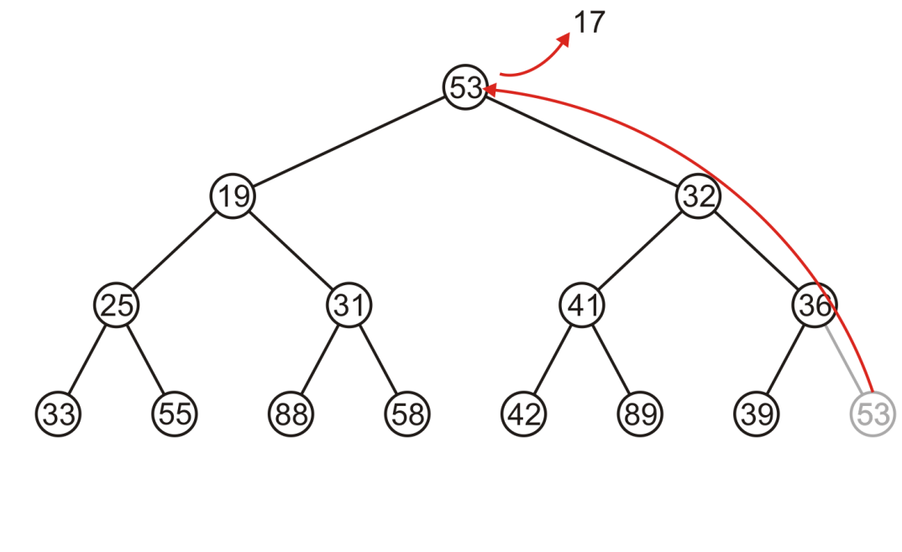
Complete Trees: Pop
In popping 17, 53 is moved to the top

Slide 58
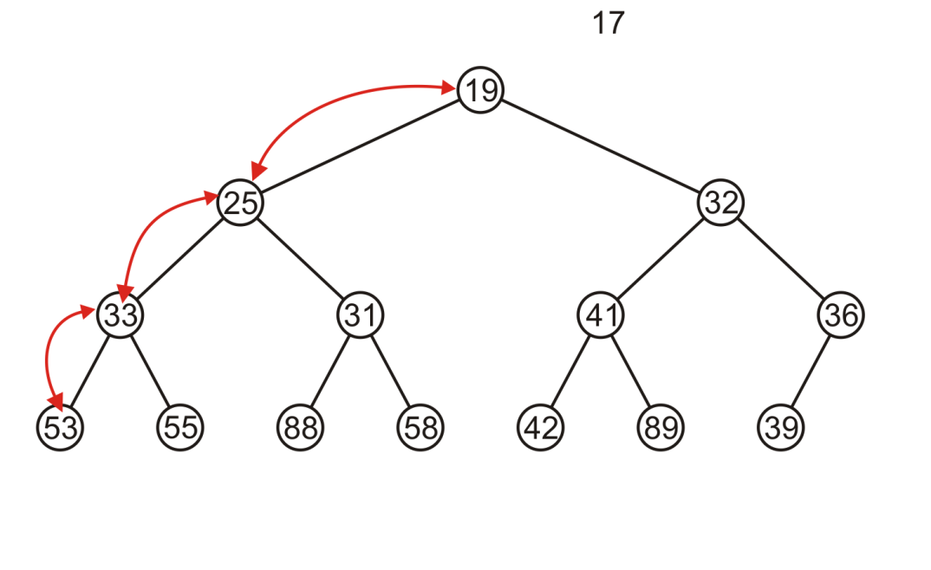
Complete Trees: Pop
And percolated down, again to the deepest level

Slide 59
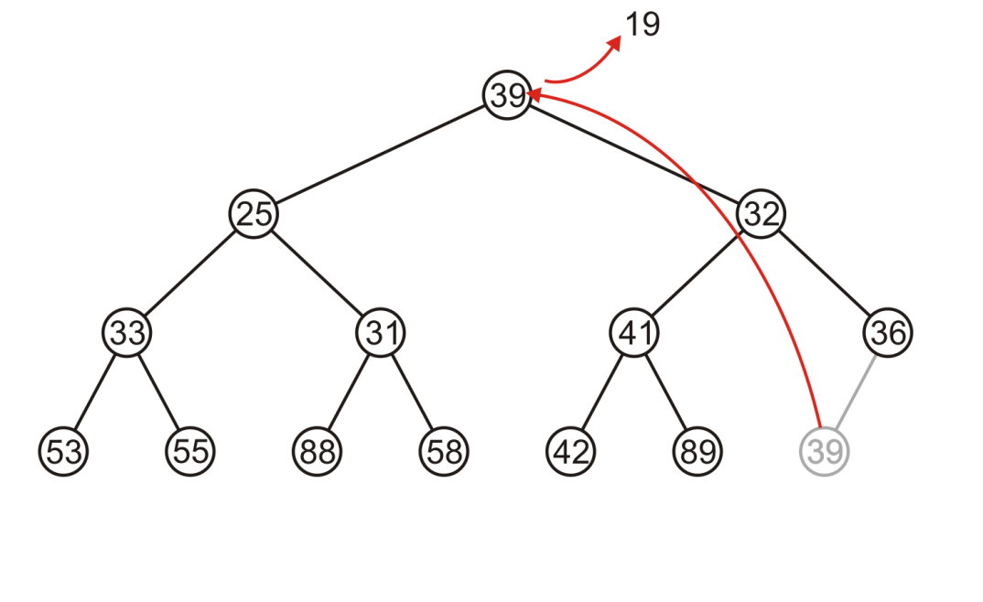
Complete Trees: Pop
Popping 19 copies up 39

Slide 60
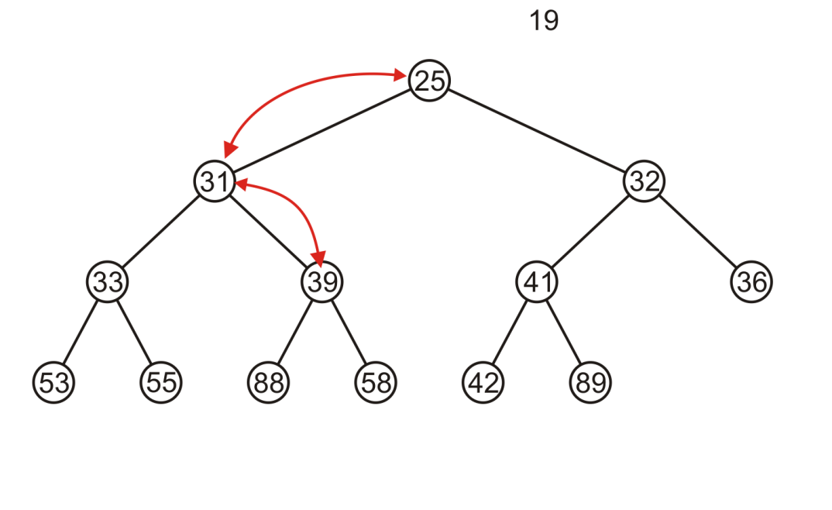
Complete Trees: Pop
Which is then percolated down to the second deepest level

Slide 61
Complete Tree
Therefore, we can maintain the complete-tree shape of a heap
We may store a complete tree using an array:
The array is filled using breadth-first traversal on the tree

Slide 62

Array Implementation
For the heap
a breadth-first traversal yields:

Slide 63
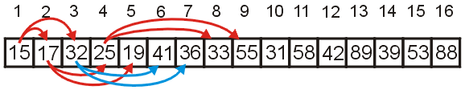
Array Implementation
We start at index 1 when filling the array.
Given the entry at index k, it follows that:
The parent of node is a k/2 parent = k >> 1;
the children are at 2k and 2k + 1 left_child = k << 1; right_child = left_child | 1;
Notes:
Cost (trivial): start array at position 1 instead of position 0

Slide 64
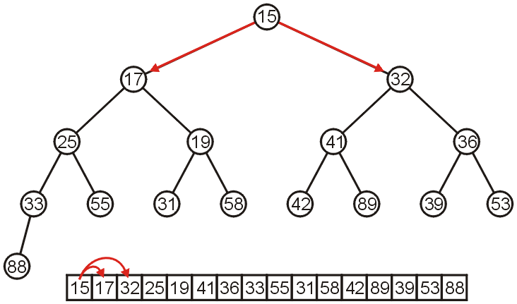
Array Implementation
The children of 15 are 17 and 32:

Slide 65
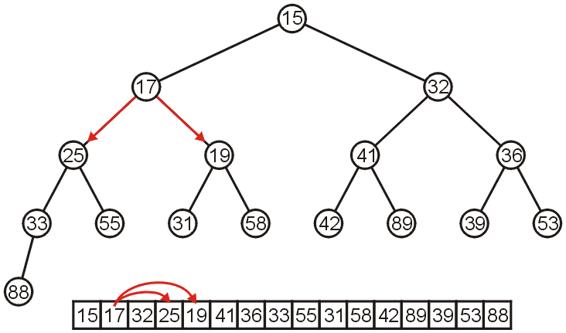
Array Implementation
The children of 17 are 25 and 19:

Slide 66
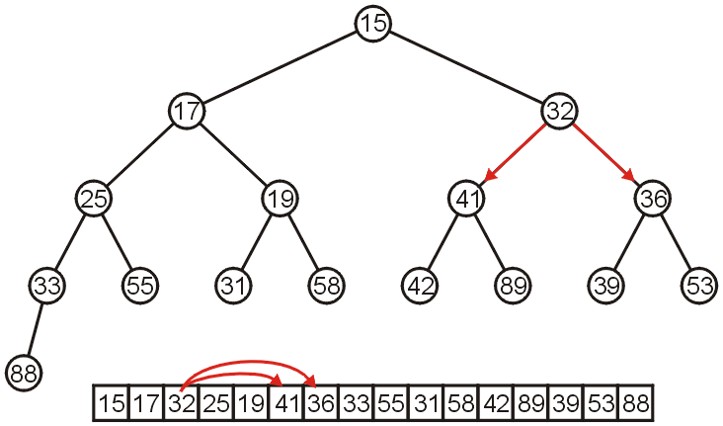
Array Implementation
The children of 32 are 41 and 36:

Slide 67
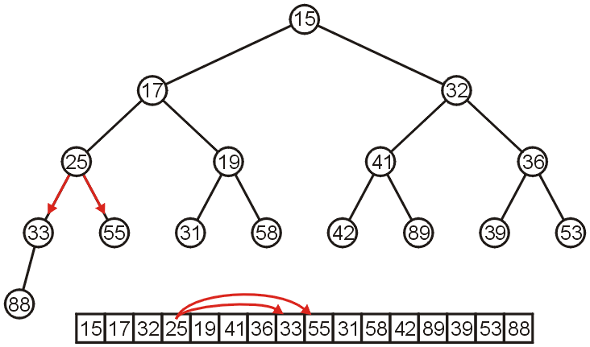
Array Implementation
The children of 25 are 33 and 55:

Slide 68
Array Implementation
If the heap-as-array has N entries, then the next empty node in the corresponding complete tree is at location L = N + 1
We compare the item at location L with the item at L/2
If they are out of order
Swap them
Set L/= 2 and repeat

Slide 69
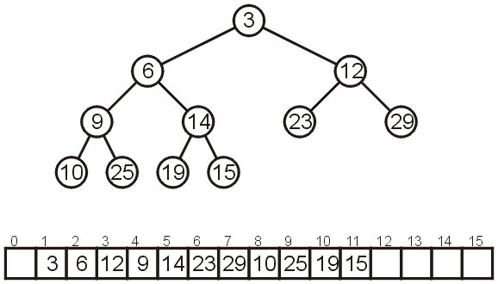
Array Implementation
Consider the following heap, both as a tree and in its array representation

Slide 70
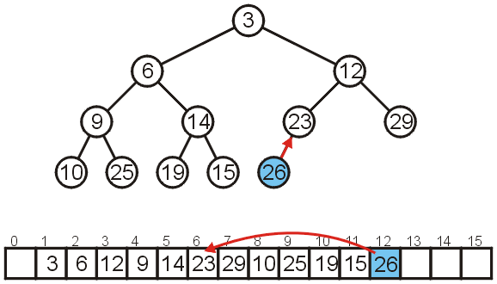
Array Implementation: Push
Inserting 26 requires no changes

Slide 71
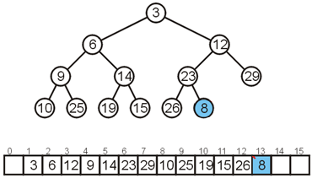
Array Implementation: Push
Inserting 8 requires a few percolations:
Swap 8 and 23

Slide 72
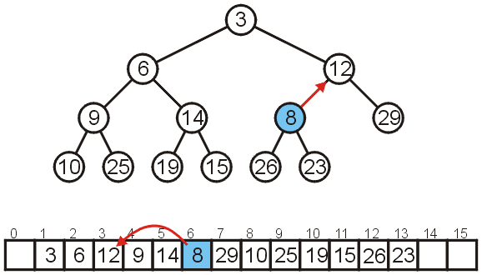
Array Implementation: Push
Swap 8 and 12

Slide 73
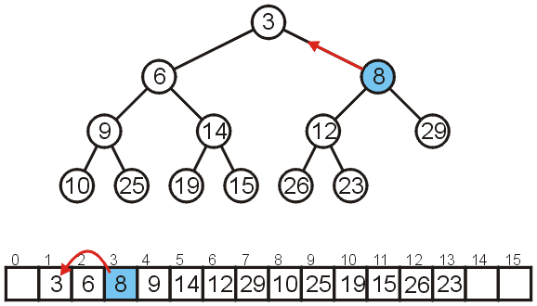
Array Implementation: Push
At this point, it is greater than its parent, so we are finished

Slide 74
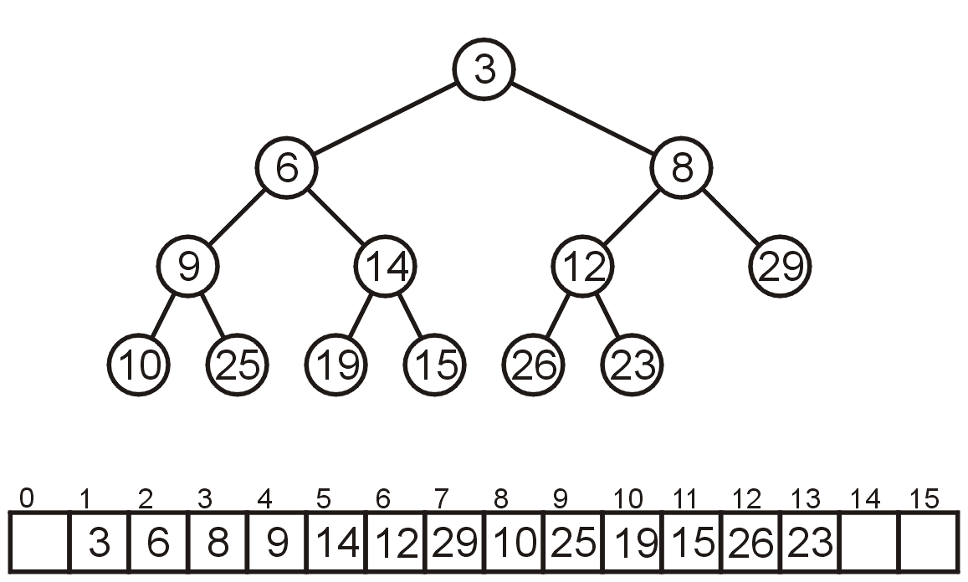
Array Implementation: Pop
As before, popping the top has us copy the last entry to the top

Slide 75
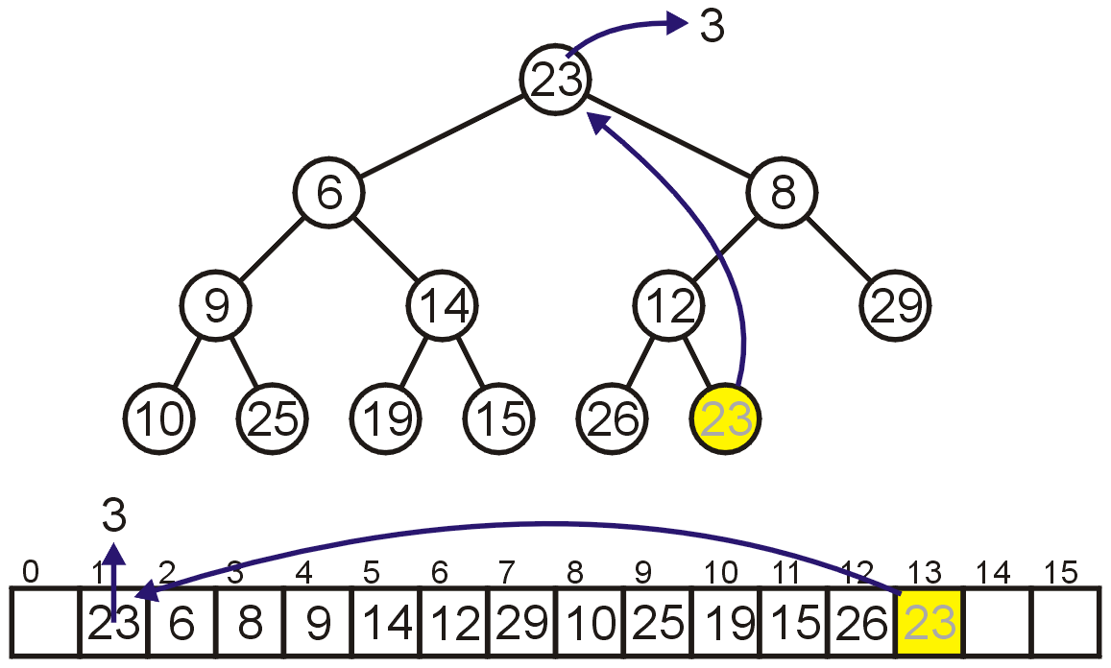
Array Implementation: Pop
As before, popping the top has us copy the last entry to the top

Slide 76
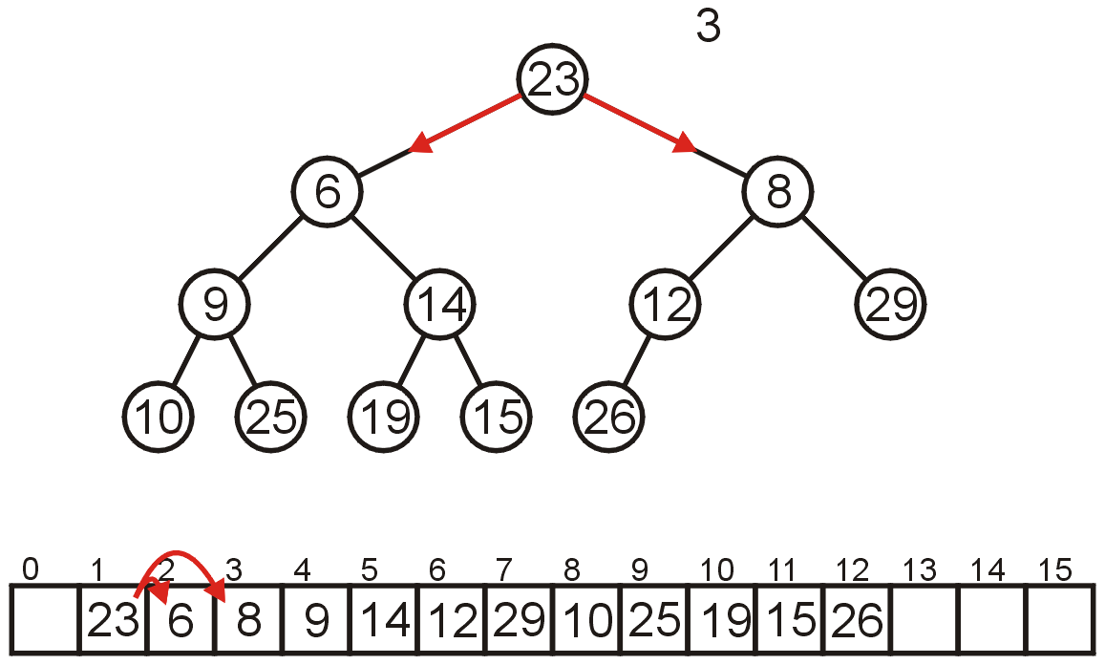
Array Implementation: Pop
Now percolate down
Compare Node 1 with its children: Nodes 2 and 3
Swap 23 and 6

Slide 77
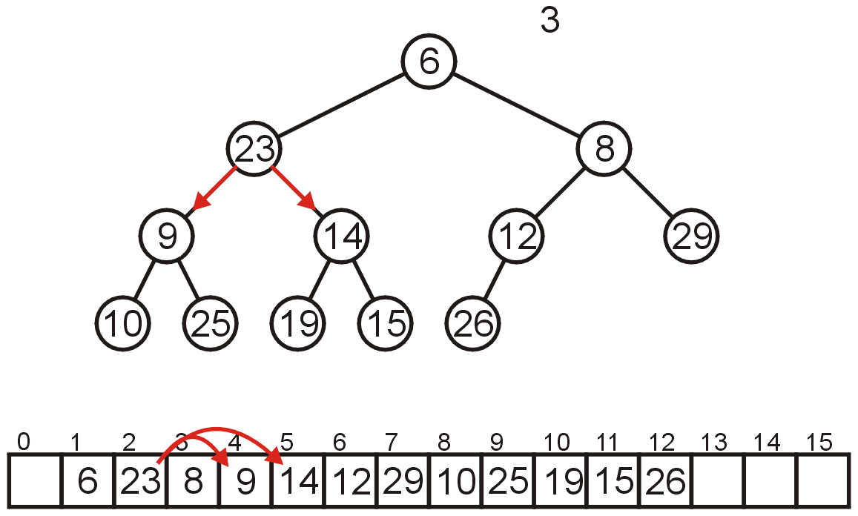
Array Implementation: Pop
Compare Node 2 with its children: Nodes 4 and 5
Swap 23 and 9

Slide 78
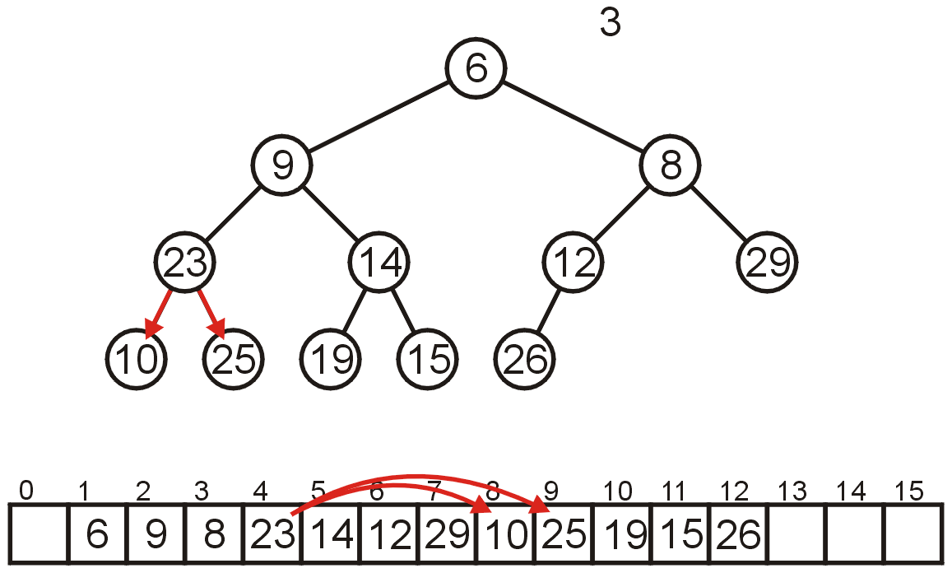
Array Implementation: Pop
Compare Node 4 with its children: Nodes 8 and 9
Swap 23 and 10

Slide 79

Array Implementation: Pop
The children of Node 8 are beyond the end of the array:
Stop

Slide 80

Array Implementation: Pop
The result is a binary min-heap

Slide 81

Array Implementation: Pop
Dequeuing the minimum again:
Copy 26 to the root

Slide 82

Array Implementation: Pop
Compare Node 1 with its children: Nodes 2 and 3
Swap 26 and 8

Slide 83

Array Implementation: Pop
Compare Node 3 with its children: Nodes 6 and 7
Swap 26 and 12

Slide 84

Array Implementation: Pop
The children of Node 6, Nodes 12 and 13 are unoccupied
Currently, N == 11

Slide 85

Array Implementation: Pop
The result is a min-heap

Slide 86

Array Implementation: Pop
Dequeuing the minimum a third time:
Copy 15 to the root

Slide 87

Array Implementation: Pop
Compare Node 1 with its children: Nodes 2 and 3
Swap 15 and 9

Slide 88

Array Implementation: Pop
Compare Node 2 with its children: Nodes 4 and 5
Swap 15 and 10

Slide 89

Array Implementation: Pop
Compare Node 4 with its children: Nodes 8 and 9
15 < 23 and 15 < 25 so stop

Slide 90

Array Implementation: Pop
The result is a properly formed binary min-heap

Slide 91

Array Implementation: Pop
After all our modifications, the final heap is

Slide 92
Run-time Analysis
Accessing the top object is Θ(1)
Popping the top object is O(ln(n))
We copy something that is already in the lowest depth—it will likely be moved back to the lowest depth
Pushing an object is also O(ln(n))
If we insert an object less than the root, it will be moved up to the top
Space complexity O(n)
So binary heap is a better implementation of priority queue

Slide 93
Run-time Analysis
If we are inserting an object less than the root (at the front), then the run time will be Θ(ln(n))
If we insert at the back (greater than any object) then the run time will be Θ(1)
How about an arbitrary insertion?
It will be O(ln(n))? Could the average be less?

Slide 94
Run-time Analysis
With each percolation, it will move an object past half of the remaining entries in the tree
Therefore, after one percolation, it will probably be past half of the entries, and therefore on average will require no more percolations
Therefore, we have an average run time of Θ(1)
Notes:
k current depth, 2^k number of node at depth k. h-k is the number of percolations

Slide 95

Run-time Analysis
An arbitrary removal requires that all entries in the heap be checked: O(n)
A removal of the largest object in the heap still requires all leaf nodes to be checked – there are approximately n/2 leaf nodes: O(n)

Slide 96

Run-time Analysis
Thus, our grid of run times is given by:

Slide 97
Run-time Analysis
Some observations:
Continuously inserting at the front of the heap (i.e., the new object being pushed is less than everything in the heap) causes the run-time to drop to O(ln(n))
If the objects are coming in order of priority, use a regular queue with swapping
Merging two binary heaps of size n is a Θ(n) operation

Slide 98
Run-time Analysis
Other heaps have better run-time characteristics
Leftist, skew, binomial and Fibonacci heaps all use a node-based implementation requiring Θ(n) additional memory
For Fibonacci heaps, the run-time of all operations (including merging two Fibonacci heaps) except pop are Θ(1)

Slide 99
Build Heap
Task: Given a set of n keys, build a heap all at once
Approach 1
Repeatedly perform push
Complexity
Ο(n ln(n))

Slide 100
Floyd’s Method
Put the keys in a binary tree and fix the heap property!
buildHeap(){
for (i=size/2; i>0; i--)
percolateDown(i);
}
12
5
11
3
10
6
9
4
8
1
7
2
12
5
11
3
10
6
9
4
8
1
7
2
Notes:
Pull other slide back up and ask how long it takes.
O(n log n) worst case, but O(n) average case.
Can we get a worst case O(n) bound?
Let’s try pretending it’s a heap already and just fixing the heap-order property.
The red nodes are the ones that are out of order.
Question: which nodes MIGHT be out of order in any heap?

Slide 101
12
12
5
11
5
11
3
10
2
9
3
1
2
9
4
8
1
7
6
4
8
10
7
6
12
12
5
2
1
2
3
1
6
9
3
5
6
9
4
8
10
7
11
4
8
10
7
11

Slide 102
Finally…
1
3
2
4
5
6
9
12
8
10
7
11
Notes:
How long does this take? Well, everything above the fringe might move 1 step.
Everything height 2 or greater might move 2 steps.
…
In other words n * Sum I=0 to n of I/2^{i}
But, this is (as n->inf) just 2. See chapter I to see why.
So, the runtime is O(n).

Slide 103
Complexity of Build Heap
No percolation for the leaf nodes (n/2 nodes)
At most n/4 nodes percolate down 1 level at most n/8 nodes percolate down 2 levels at most n/16 nodes percolate down 3 levels …
Θ(n)
Notes:
Fact: size of a perfect binary tree doubles (+1) with each additional layer

Slide 104

Binary Max Heaps
A binary max-heap is identical to a binary min-heap except that the parent is always larger than either of the children
For example, the same data as before stored as a max-heap yields

Slide 105
Outline
Priority queue
Binary heap
Heapsort

Slide 106
Heapsort
Sorting
take a list of objects (a₀, a₁, ..., a_{n – 1})
return a reordering (a'₀, a'₁, ..., a'_{n – 1}) such that a'₀ ≤ a'₁ ≤ · · · ≤ a'_{n – 1}
Heapsort
Place the objects into a heap
O(n) time
Repeatedly popping the top object until the heap is empty
O(n ln(n)) time
Time complexity: O(n ln(n))

Slide 107
In-place Implementation
Problem:
This solution requires additional memory: a min-heap of size n
This requires Θ(n) memory
If the unsorted objects are stored in an array, is it possible to perform a heap sort in place, that is, require at most Θ(1) memory (a few extra variables)?

Slide 108
In-place Implementation
Instead of implementing a min-heap, consider a max-heap:
The maximum element is at the top of the heap
We then repeatedly pop the top object and move it to the end of the array.

Slide 109


In-place Implementation
Now, consider this unsorted array:
This array represents the following complete tree:

Slide 110
In-place Implementation
Now, consider this unsorted array:
Because we start at 0 (instead of 1 as in array storage of complete trees), we need different formulas for finding the children and parent
Children 2*k + 1 2*k + 2
Parent (k + 1)/2 - 1

Slide 111
Example Heap Sort
First, we must convert the unordered array with n = 10 elements into a max-heap
None of the leaf nodes need to be percolated down, and the last non-leaf node is in position n/2-1
Thus, we start with position 10/2-1 = 4

Slide 112

Example Heap Sort
We compare 3 with its child and swap them

Slide 113

Example Heap Sort
We compare 17 with its two children and swap it with the maximum child (81)

Slide 114

Example Heap Sort
We compare 28 with its two children, 63 and 34, and swap it with the largest child

Slide 115

Example Heap Sort
We compare 52 with its children, swap it with the largest
Recursing, no further swaps are needed

Slide 116

Example Heap Sort
Finally, we swap the root with its largest child, and recurse, swapping 46 again with 81, and then again with 70

Slide 117

Heap Sort Example
We have now converted the unsorted array
into a max-heap:

Slide 118


Heap Sort Example
We pop the maximum element of this heap
This leaves a gap at the back of the array:

Slide 119


Heap Sort Example
This is the last entry in the array, so why not fill it with the largest element?
Repeat this process: pop the maximum element, and then insert it at the end of the array:

Slide 120


Heap Sort Example
Repeat this process
Pop and append 70
Pop and append 63

Slide 121


Heap Sort Example
We have the 4 largest elements in order
Pop and append 52
Pop and append 46

Slide 122


Heap Sort Example
Continuing...
Pop and append 34
Pop and append 28

Slide 123

Heap Sort Example
Finally, we can pop 17, insert it into the 2nd location, and the resulting array is sorted

Slide 124

Example
Here we have a max-heap of presents under a red-green tree:
http://xkcd.com/835/

Slide 125
Priority Queues
Now, does using a heap ensure that that object in the heap which:
has the highest priority, and
of that highest priority, has been in the heap the longest
Consider inserting seven objects, all of the same priority (colour indicates order):
2, 2, 2, 2, 2, 2, 2

Slide 126

Priority Queues
Whatever algorithm we use for promoting must ensure that the first object remains in the root position
Thus, we must use an insertion technique where we only percolate up if the priority is lower
The result:
Challenge:
Come up with an algorithm which removes all seven objects in the original order

Slide 127

Lexicographical Ordering
A better solution is to modify the priority:
Track the number of insertions with a counter k (initially 0)
For each insertion with priority n, create a hybrid priority (n, k) where:
(n₁, k₁) < (n₂, k₂) if n₁ < n₂ or (n₁ = n₂ and k₁ < k₂)

Slide 128
Priority Queues
Removing the objects would be in the following order:

Slide 129

Priority Queues
Popped: 2
First, (2,1) < (2, 2) and (2, 3) < (2, 4)

Slide 130

Priority Queues
Removing the objects would be in the following order:

Slide 131

Priority Queues
Removing the objects would be in the following order:

Slide 132

Priority Queues
Removing the objects would be in the following order:

Slide 133

Priority Queues
Removing the objects would be in the following order:

Slide 134
Summary
In this talk, we have:
Discussed binary heaps
Looked at an implementation using arrays
Analyzed the run time:
Head Θ(1)
Push Θ(1) average
Pop O(ln(n))
Discussed implementing priority queues using binary heaps
The use of a lexicographical ordering

Slide 135
Summary
Priority queue
pop the object with the highest priority
Binary heap
Operations
Top Θ(1)
Push O(ln(n))
Pop O(ln(n))
Build Θ(n)
Implementation using arrays
Heapsort
Time: O(n ln(n))
Space: O(1)

Slide 136
References
[1] Donald E. Knuth, The Art of Computer Programming, Volume 3: Sorting and Searching, 2nd Ed., Addison Wesley, 1998, §7.2.3, p.144.
[2] Cormen, Leiserson, and Rivest, Introduction to Algorithms, McGraw Hill, 1990, §7.1-3, p.140-7.
[3] Weiss, Data Structures and Algorithm Analysis in C++, 3rd Ed., Addison Wesley, §6.3, p.215-25.

Slide 137
Usage Notes
These slides are made publicly available on the web for anyone to use
If you choose to use them, or a part thereof, for a course at another institution, I ask only three things:
that you inform me that you are using the slides,
that you acknowledge my work, and
that you alert me of any mistakes which I made or changes which you make, and allow me the option of incorporating such changes (with an acknowledgment) in my set of slides
Sincerely,
Douglas Wilhelm Harder, MMath
dwharder@alumni.uwaterloo.ca

